Slide 1

Homelabbing on the Cheap
A Step-by-Step Guide to Hands-on Hacking Using Virtual Machines

Slide 2

whoami
Aaron J. Scantlin
Security Engineer, Research Support Services, University of Missouri System
GNFA certified
DevOps Team
SciNet / SuperCompute - https://scinet.usda.gov/
Coordinator/DJ/Code of Conduct Team
SecKC – https://www.seckc.org
Freelance Speaker
Holla at ya boi :)

Slide 3
What You’ll Get From This
A brief overview of virtualization
A brief discussion on installing VirtualBox
A slightly longer discussion on virtual machine management
A roughly equally long discussion on virtual network management
A series of virtual architecture diagrams with increasing complexity representing various use cases
Links where you can read/download more

Slide 4
Problem Statement
“I have a computer and an Internet connection, and a desire to get more experience with security tools, techniques and thought processes, but I don’t know where to start.”
-You, hopefully

Slide 5
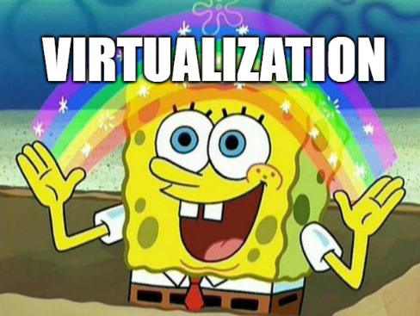

Slide 6
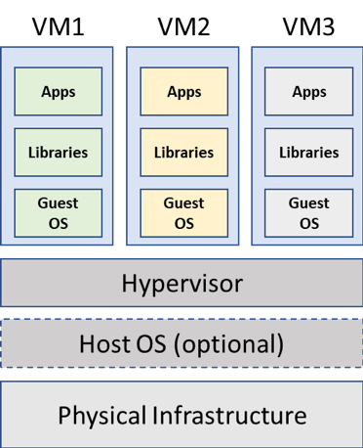
Virtualization Architecture
Image source: https://bluesentry.cloud/blog/from-virtualization-to-containerization-the-evolution-of-cloud-computing/

Slide 7
Hypervisor Options
TYPE 1
TYPE 2
FREE
Proxmox
VMware ESXi*
oVirt
PAID
VMware vSphere
Hyper-V
FREE
VirtualBox**
VMware Player***
UTM (M1-based macOS)
PAID
VMware
Workstation (Windows, Linux)
Fusion (Intel-based macOS)
*: not free for business use
**: Virtual Box Extension Pack is not free for business use
***: Windows/Linux only, one VM at a time
Notes:
Proxmox: https://www.proxmox.com/en/proxmox-ve
ESXi: https://kb.vmware.com/s/article/2107518
oVirt: https://www.ovirt.org/
VirtualBox: https://www.virtualbox.org/wiki/Downloads
VMware Player: https://www.vmware.com/products/workstation-player.html
UTM: https://mac.getutm.app/

Slide 8

Why VirtualBox?
software

Slide 9
VirtualBox Install: Windows
RTFM: http://download.virtualbox.org/virtualbox/UserManual.pdf
Video: https://www.youtube.com/watch?v=tC3GTfw78QQ
For Windows users, assuming you know how to install software, there really aren’t any surprises here. Maybe consider unchecking “Always Trust Drivers from Oracle”

Slide 10
VirtualBox Install: macOS (Intel)
RTFM: http://download.virtualbox.org/virtualbox/UserManual.pdf
Video: https://www.youtube.com/watch?v=GrMxHL23qNY
macOS users do have a bit more to watch out for
You’ll be prompted to allow some permissions during install – failing to do so will eventually require you to re-install VirtualBox
You’ll also likely be prompted for permissions the first time you start a virtual machine

Slide 11
Virtual Machine Creation and Management
VMs can be created manually or imported
CPU, RAM and Disk allocated should be based on
Available resources on the host
Required resources for the guest
Snapshots are your friend
Think of them as “save points”
Consider the pros/cons of isolation measures
Network, shared clipboard, shared folders

Slide 12
Virtual Network Creation and Management
NAT
Great for when you don’t need to communicate directly to a guest
Bridged
Won’t work with some wireless cards
Internal Network
Allows communication between other VMs on the same internal network (requires manually enabling vbox DHCP server OR using a VM to manage DHCP)

Slide 13
Virtual Network Creation and Management
Host-Only Network
Allows VMs to communicate with each other, but not the outside world
NAT Network
Basically NAT, but allows you to communicate directly to VMs from the host, and requires you to configure a NAT network in vbox settings
NOTE: If you’re coming from VMware, this is going to be what you’re probably most used to
There are a few other network adapter types, but I haven’t needed ‘em.

Slide 14


Slide 15


Guest VM
NAT
Host System
Notes:
Ubuntu Linux: https://ubuntu.com/

Slide 16


Notes:
Fedora Linux: https://getfedora.org/
Alma Linux: https://almalinux.org/

Slide 17
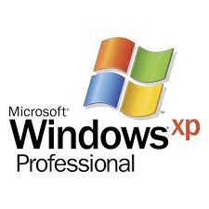
Host-Only
Notes:
Windows XP image: https://archive.org/details/xp51_20191108

Slide 18



NAT
Internal Network
Notes:
pfSense: https://www.pfsense.org/download/
Kali Linux: https://www.kali.org/get-kali/#kali-virtual-machines

Slide 19
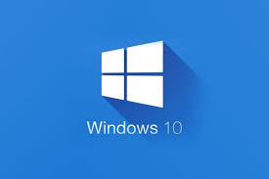
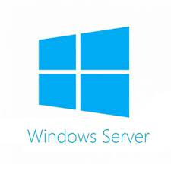
NAT
Internal Network
Notes:
Windows Server, 10 Eval VMs: https://www.microsoft.com/en-us/evalcenter/

Slide 20
+ iNetSim
Host-only Network 1
Host-only Network 2
Notes:
iNetSim: https://www.inetsim.org/

Slide 21
Intentionally Vulnerable VMs
Metasploitable 2, Metasploitable 3
https://sourceforge.net/projects/metasploitable/files/Metasploitable2/
https://github.com/rapid7/metasploitable3
Vulnhub
Lots of VMs you can download and import locally
Totally free – these folks are awesome
Hack the Box
Subscription service that offers a rotating free VM each week
FWIW, I’ve heard many happy customers of this service
List compiled by https://andreafortuna.org/2020/07/22/vulnerable-webapps-and-vms-for-penetration-testing-practice-my-own-list/
Notes:
VulnHub: https://www.vulnhub.com/
Hack The Box: https://www.hackthebox.com/

Slide 22
Summary
Odds are the random hardware you have lying around supports virtualization
Virtualization gives you the capability to emulate virtually anything
Useful for almost everyone in an IT role
Helps support security efforts across multiple systems
Facilitates legal hands-on learning with offensive security tools

Slide 23
Questions? Comments?
hackerman@missouri.edu
Twitter/Discord/basically any social I’m on: @sysaaron
Slides+Recording will be posted to GitHub: https://github.com/coffeebro
(Big ups to Mizzou for letting me take the time to come talk!)

